Slide 1
RXJS Make it simple
Ngo Hung Phuc

Slide 2
Agenda
What is RXJS ? Benefit of RXJS
Understand Observable, Observer
Subject, BehaviorSubject, ReplaySubject, AsyncSubject
SwitchMap, ExhaustMap, MergeMap (FlatMap), ConcatMap
Pipe operator & benefit
26 Common operators in RXJS
Useful resource
Talk is cheap. Show me the code.

Slide 3
Understand Observable
Observables are declarative which provide support for passing messages between publishers and subscribers in your application. They are mainly used for event handling, asynchronous programming, and handling multiple values.
In this case, you define a function for publishing values, but it is not executed until a consumer subscribes to it. The subscribed consumer then receives notifications until the function completes, or until they unsubscribe.

Slide 4
Observer
Observer is an interface for a consumer of push-based notifications delivered by an Observable. It has below structure
interface Observer<T> {
closed?: boolean;
next: (value: T) => void;
error: (err: any) => void;
complete: () => void;
}
A handler that implements the Observer interface for receiving observable notifications will be passed as a parameter for observable as below
myObservable.subscribe(myObserver);
Note: If you don't supply a handler for a notification type, the observer ignores notifications of that type.

Slide 5
What is RXJS
RxJS is one of the hottest libraries in web development today. Offering a powerful, functional approach for dealing with events and with integration points into a growing number of frameworks, libraries, and utilities
https://tylermcginnis.com/imperative-vs-declarative-programming/

Slide 6
Subject
A Subject is a special type of Observable which shares a single execution path among observers.
You can think of this as a single speaker talking at a microphone in a room full of people. Their message (the subject) is being delivered to many (multicast) people (the observers) at once. This is the basis of multicasting. Typical observables would be comparable to a 1 on 1 conversation.

Slide 7
Subject, BehaviorSubject, ReplaySubject, AsyncSubject
There are 4 variants of subjects:
Subject - No intial value or replay behavior.
AsyncSubject - Emits latest value to observers upon completion.
BehaviorSubject - Requires an initial value and emits its current value (last emitted item) to new subscribers.
ReplaySubject - Emits specified number of last emitted values (a replay) to new subscribers.
Small Demo
Notes:
https://stackblitz.com/edit/rxjs-subjects-comparison?file=index.ts&devtoolsheight=100

Slide 8
SwitchMap
SwitchMap:
The main difference between switchMap and other flattening operators is the cancelling effect. On each emission the previous inner observable (the result of the function you supplied) is cancelled and the new observable is subscribed (if new emitted value emit fast enough).
You can remember this by the phrase switch to a new observable.
https://stackblitz.com/edit/typescript-s4pvix?file=index.ts&devtoolsheight=100

Slide 9
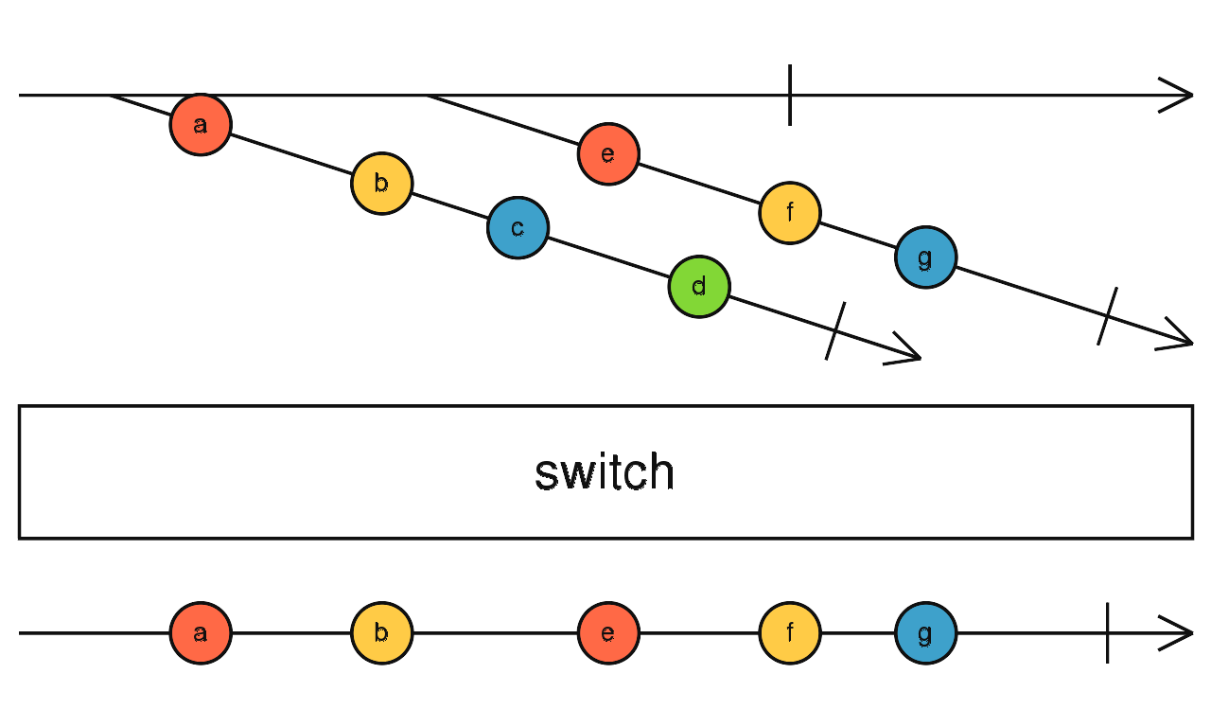
SwitchMap

Slide 10
MergeMap
This operator is best used when you wish to flatten an inner observable.
When using switchMap each inner subscription is completed when the source emits, allowing only one active inner subscription.
In contrast, mergeMap allows for multiple inner subscriptions to be active at a time
https://stackblitz.com/edit/typescript-f8ghcx?file=index.ts&devtoolsheight=100

Slide 11
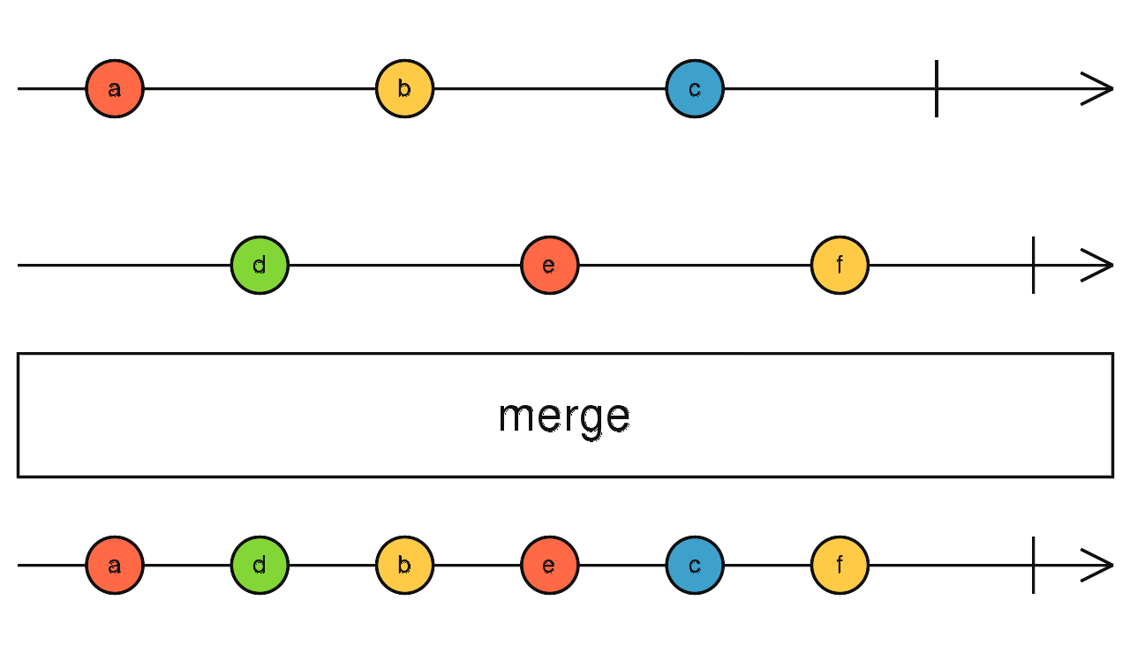
MergeMap

Slide 12
ConcatMap
When source stream emits, concatMap will call inner function to get inner stream that it will switch to. Once switched to inner stream, concatMap will wait for it to complete, before getting a new inner streams on following source emissions
https://stackblitz.com/edit/typescript-rv9byk?file=index.ts&devtoolsheight=100

Slide 13
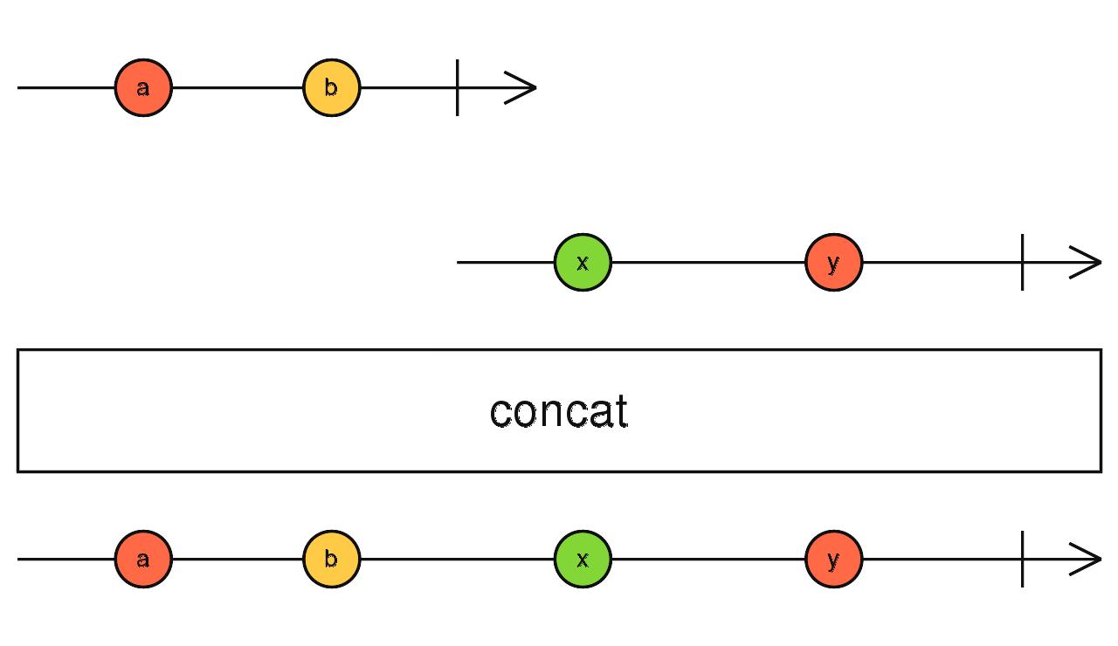
ConcatMap

Slide 14
ExhaustMap
There are other situations where what we want to do is to ignore new values in the source Observable until the previous value is completely processed.
When source stream emits, exhaustMap will call inner function to get inner stream that it will switch to. Once switched to inner stream, exhaustMap will ignore values from source stream until inner stream completes

Slide 15
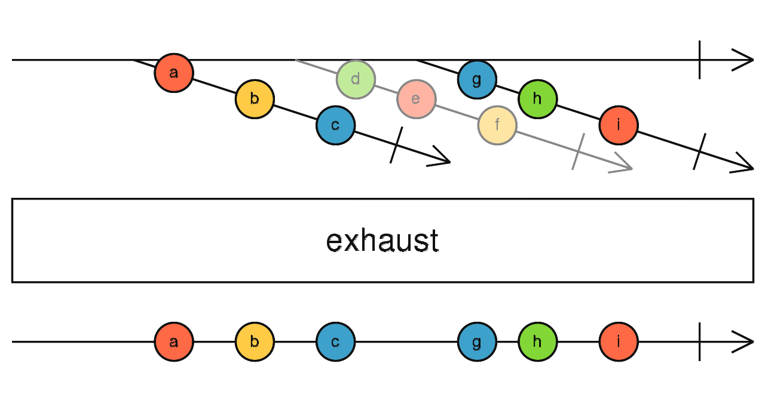
ExhaustMap

Slide 16
Note
mergeMap = map + mergeAll
concatMap = map + concatAll
switchMap = map + switch
concatMap will wait for previous observable complete before execute next observable. In contrast mergeMap don’t
MergeMap will be parallel
ConcatMap will be sequentially

Slide 17
Pipe operator & benefit
Pipe is a method on Observable which is used for composing operators similar manner to what with dot-chaining.
Benfit of pipe operator:
By importing only operators you need instead of the entire RxJS library you can significantly reduce the total bundle size
Intellisense
Avoid collisions if two different parties wanted to create an operator of the same name.

Slide 18
26 Common operators

Slide 19
Useful resource
https://www.learnrxjs.io/
https://thinkrx.io/
https://xgrommx.github.io/rx-book/content/which_operator_do_i_use/index.html
https://youtu.be/_q-HL9YX_pk
https://youtu.be/ak3MvMn8u18
https://blog.angular-university.io/rxjs-higher-order-mapping/
https://rxjs-dev.firebaseapp.com/operator-decision-tree

